Slide 1

High Altitude Balloon Research
Symposium Presentation
Pima Community College
By Brody Dyer
Mentors: AnnMarie Condes and Caroline Torres

Slide 2
Fall 21 Abstract
The primary objective of the experimental payload is to measure the altitude, pressure, and temperature of the atmosphere. By recording these three variables, important information can be obtained. Another interesting variable is the relationship between various gasses throughout the atmosphere. The payload will accomplish this with oxygen, carbon dioxide and nitrogen sensors, each one recording its respective gas. This determines where in the atmosphere each gas is most abundant. The payload will also include a camera, recording the payloads journey throughout the atmosphere, as well as it’s descent back down.

Slide 3
Spring 22 Abstract
The objective of the Spring 2022 payload is to observe how salt solutions behaves under different levels of pressure, temperature and altitude as it moves into the upper atmosphere. The behavior of the salt solutions will give some insight into the human body, specifically human blood and intercellular fluid, to the upper levels of the atmosphere with little to no protection. The behavior of the salt solutions will be recorded throughout the flight by a GoPro video camera. The temperature, pressure and altitude will be measured by a BME 280, run by an Arduino Uno. Additionally, a PixPro 360º video camera will record the duration of the ascent and descent of the payload. One individual 7.3 volt battery will power the Arduino, BME,
and Data Logger.

Slide 4
Fall 21- Objectives
Record the concentration of CO₂, NO₂, and various hydrocarbons in the atmosphere (ppm)
Record video of the launch (ascent/descent)
Log/ Record Data of the sensors via a BME:
  Altitude, pressure, and temperature
  Various Gas Abundance
Ascend 100,000 ft in altitude.

Slide 5
Spring 22- Objectives
Record abundance of CO₂, NO₂, and various hydrocarbons in the atmosphere (ppm)
Record video of the launch (ascent/descent)
Record video of NaHCO₃ solutions behavior to the conditions of the upper atmosphere.
Log/ Record Data of the launch in ppm
  Altitude, pressure, and temperature
Ascend 100,000 ft in the atmosphere

Slide 6
Payload Design
The same payload was used for both Fall and Spring semester flight. For the Spring launch, the interior of the shell had to be modified in order to ﬁt an interior camera and the cuvette holder.

Slide 7
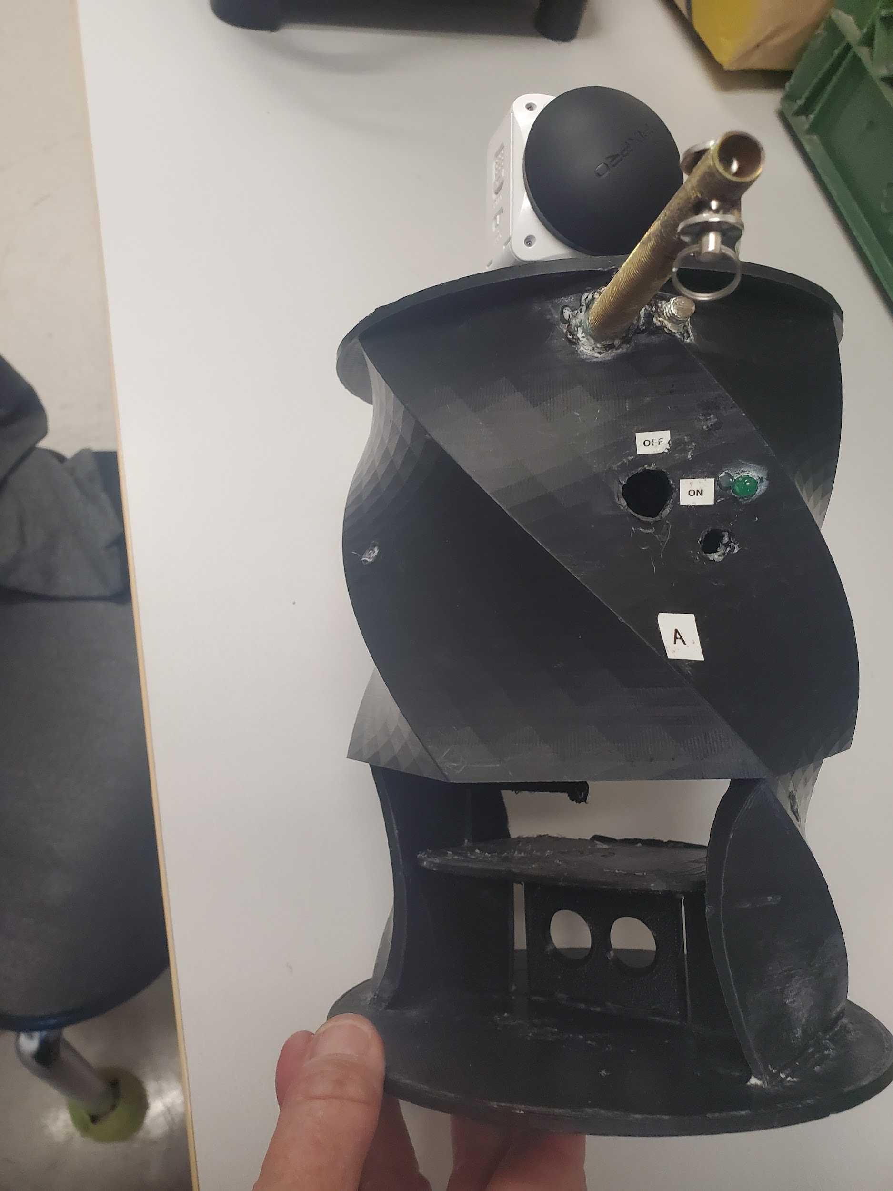
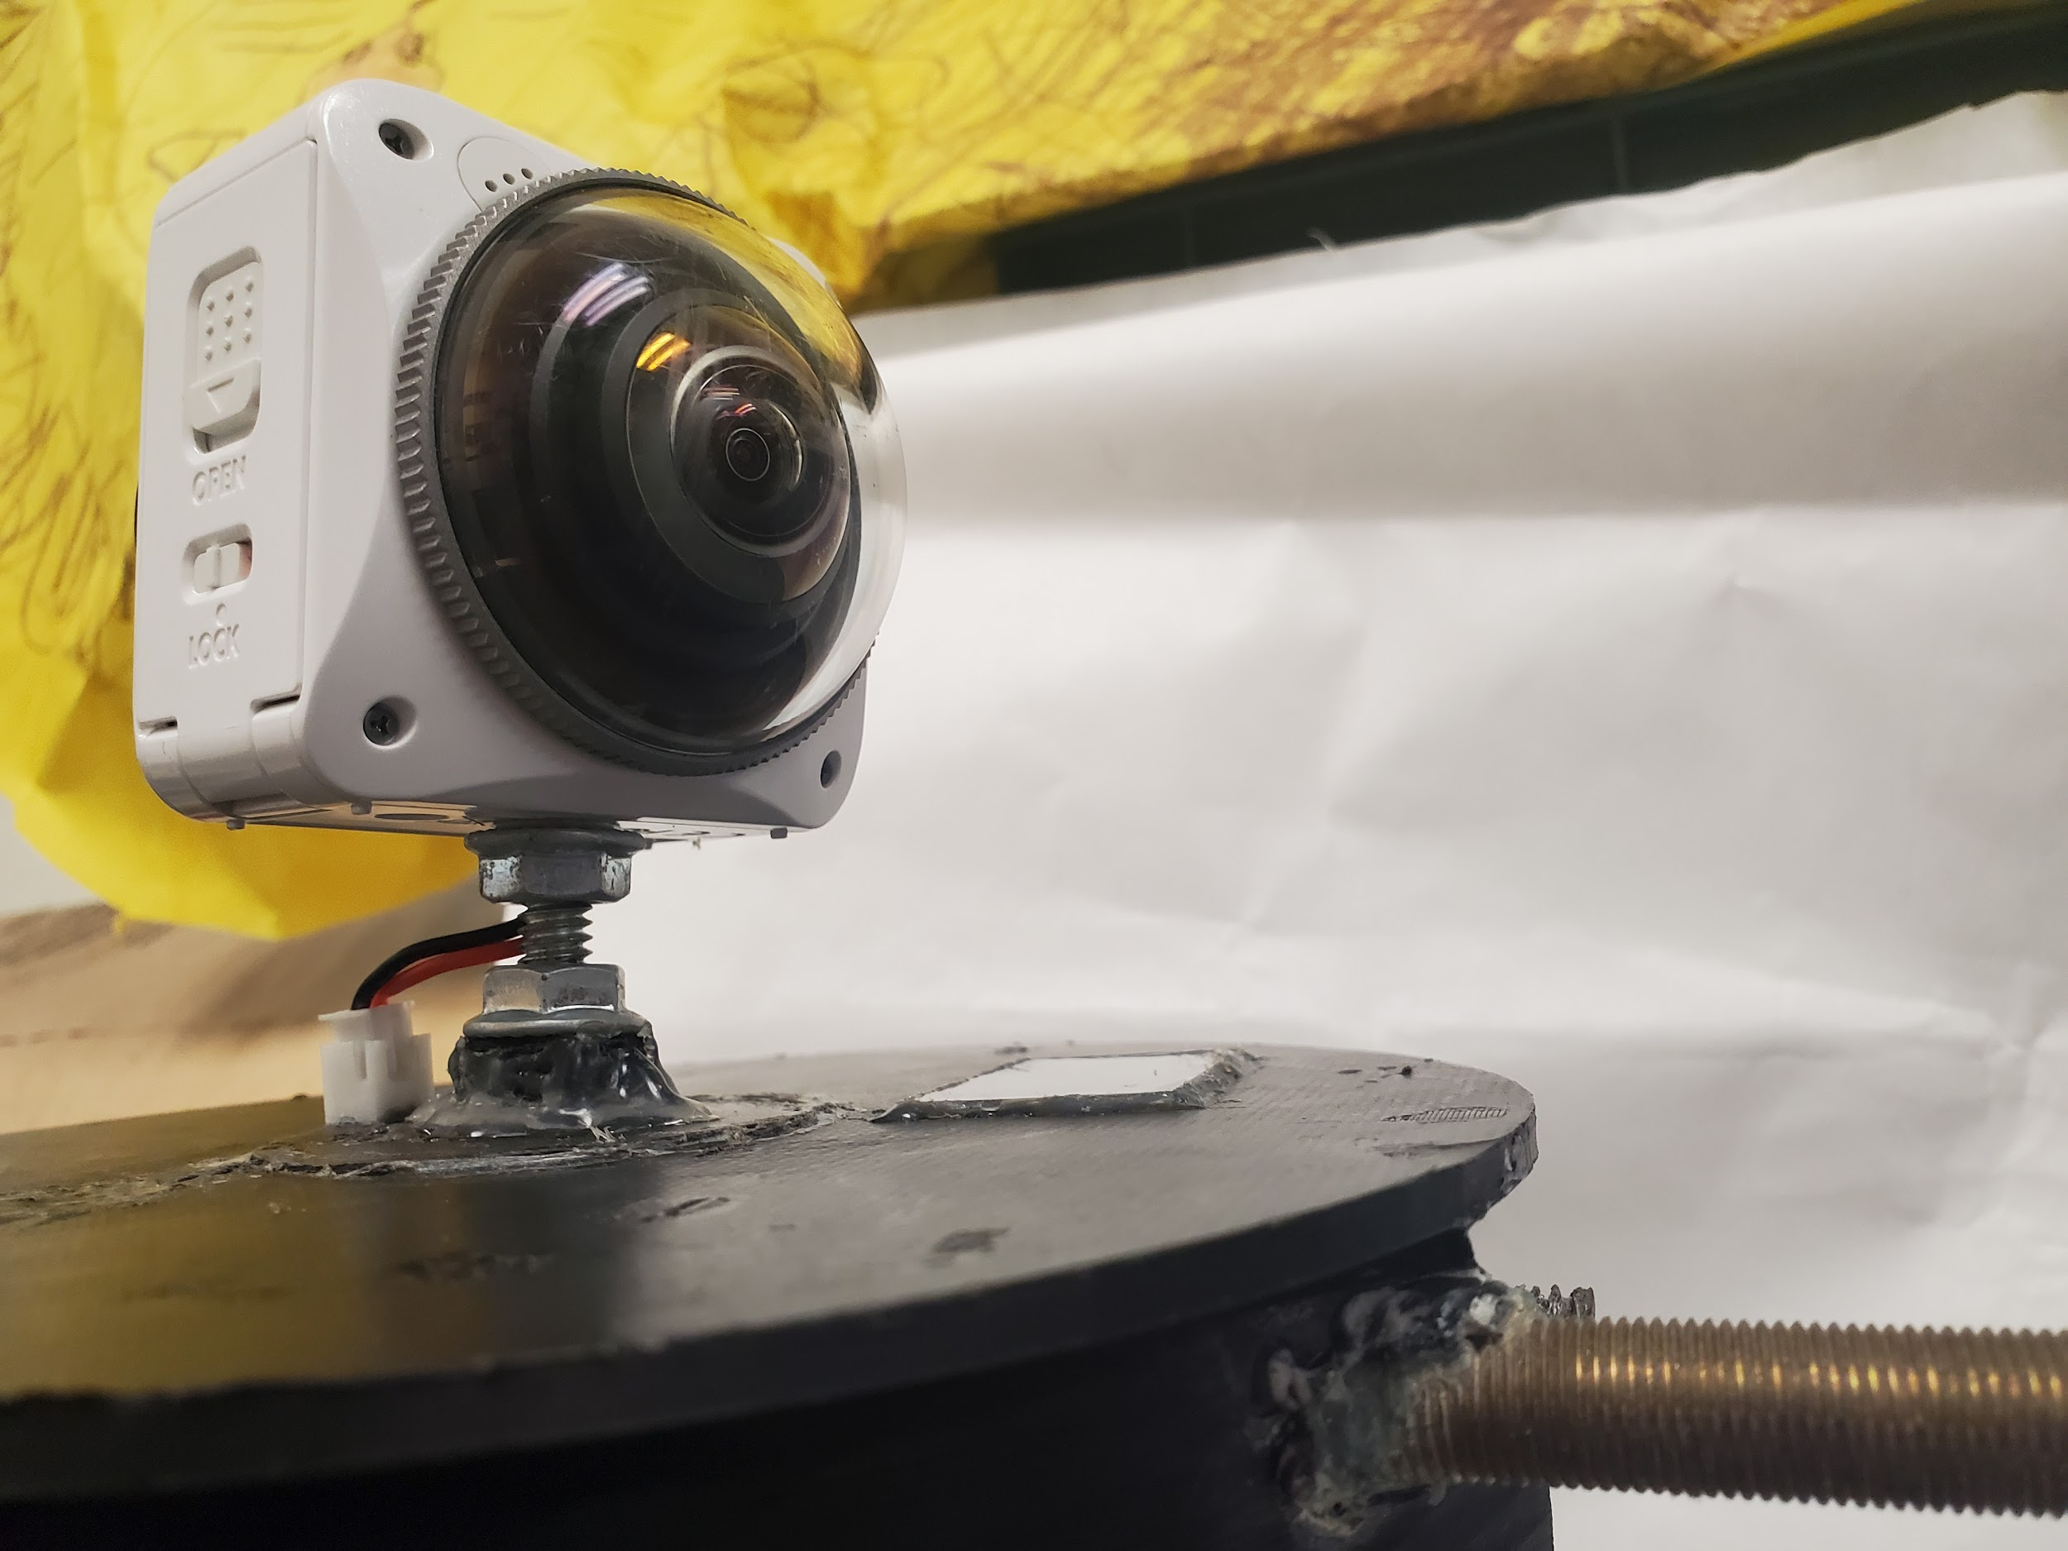
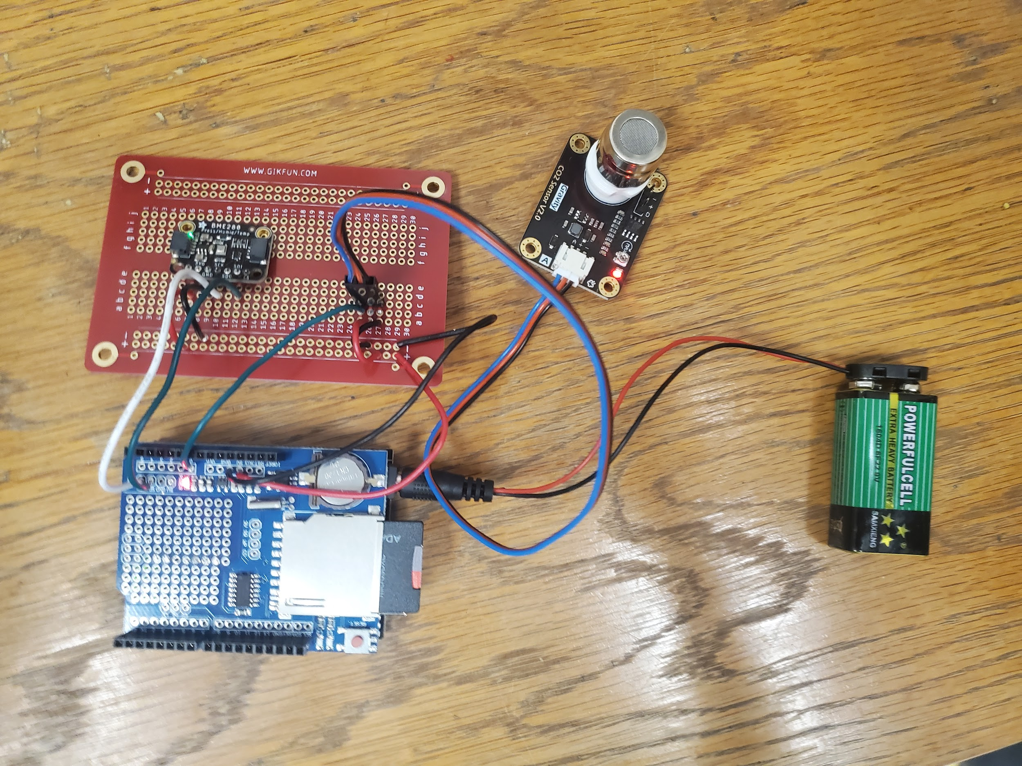
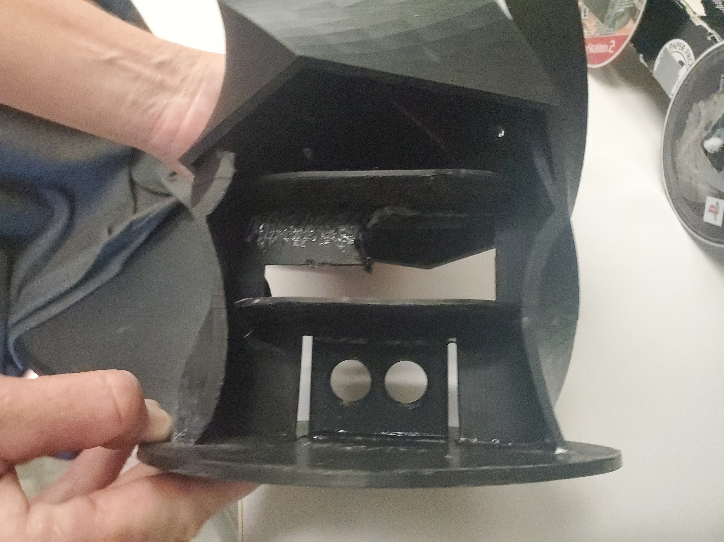
Pictures of Fall Payload

Slide 8
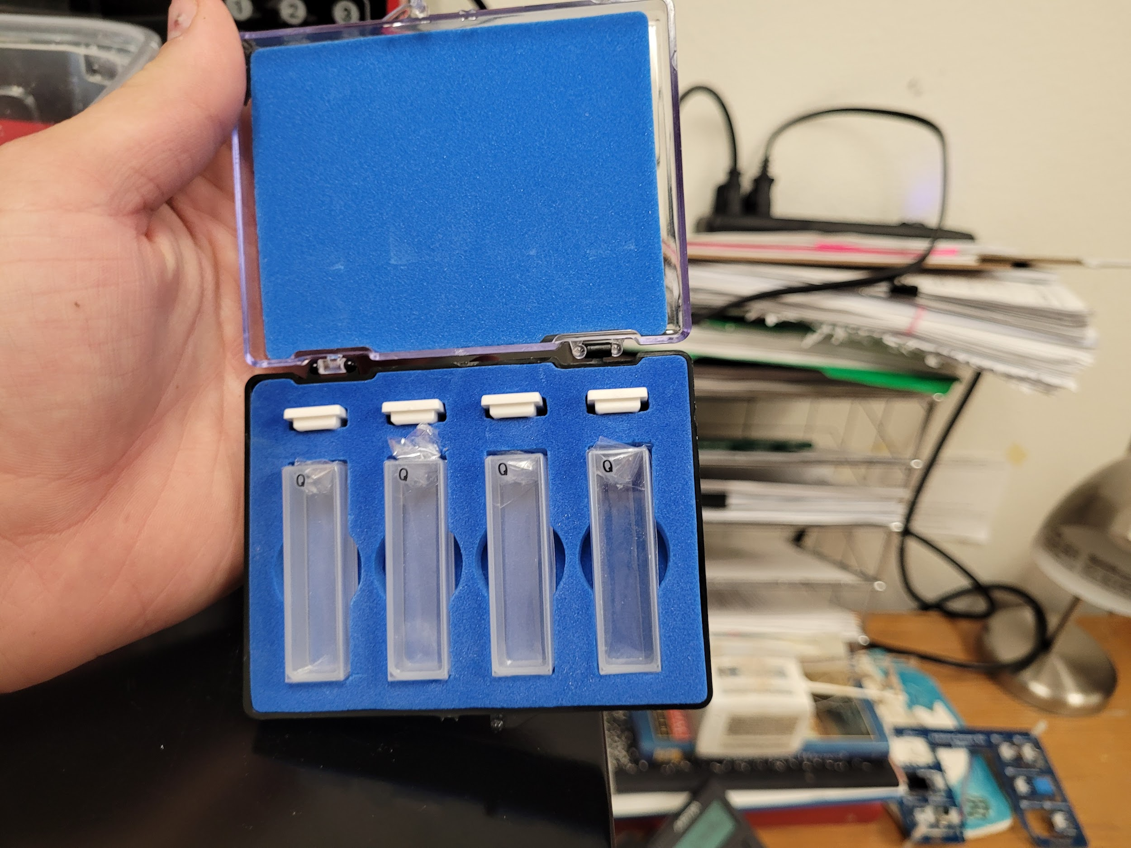
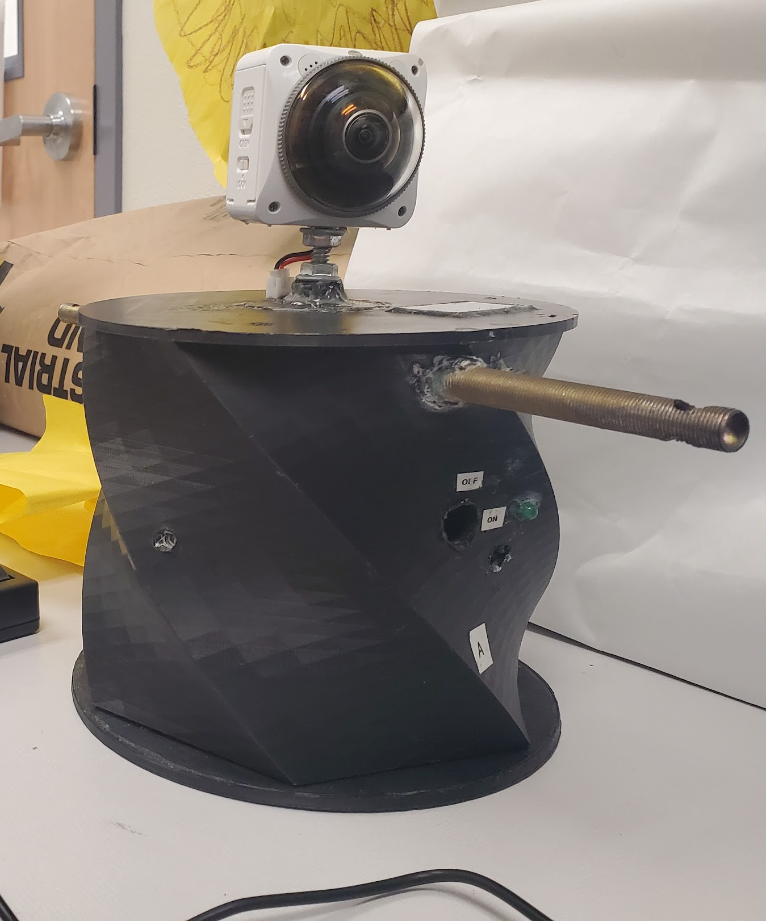
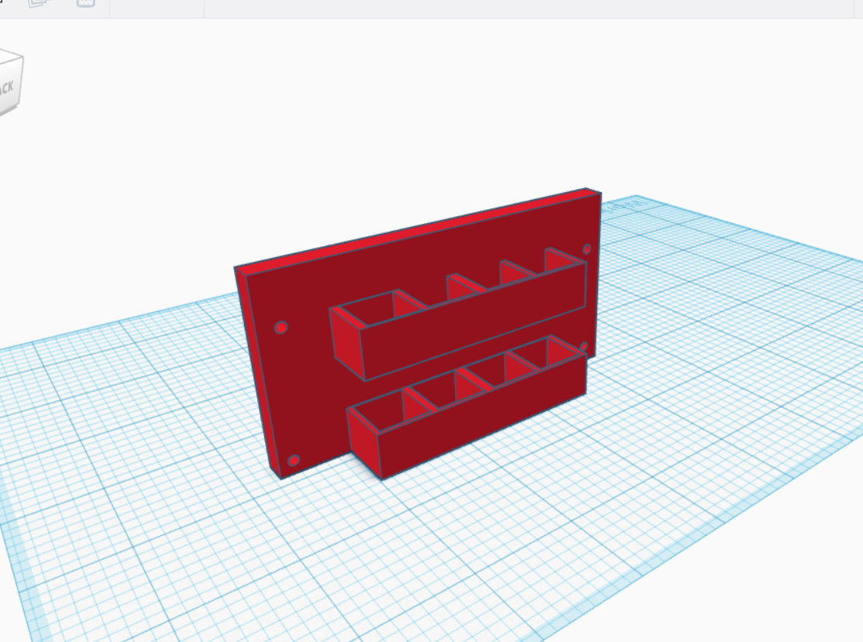
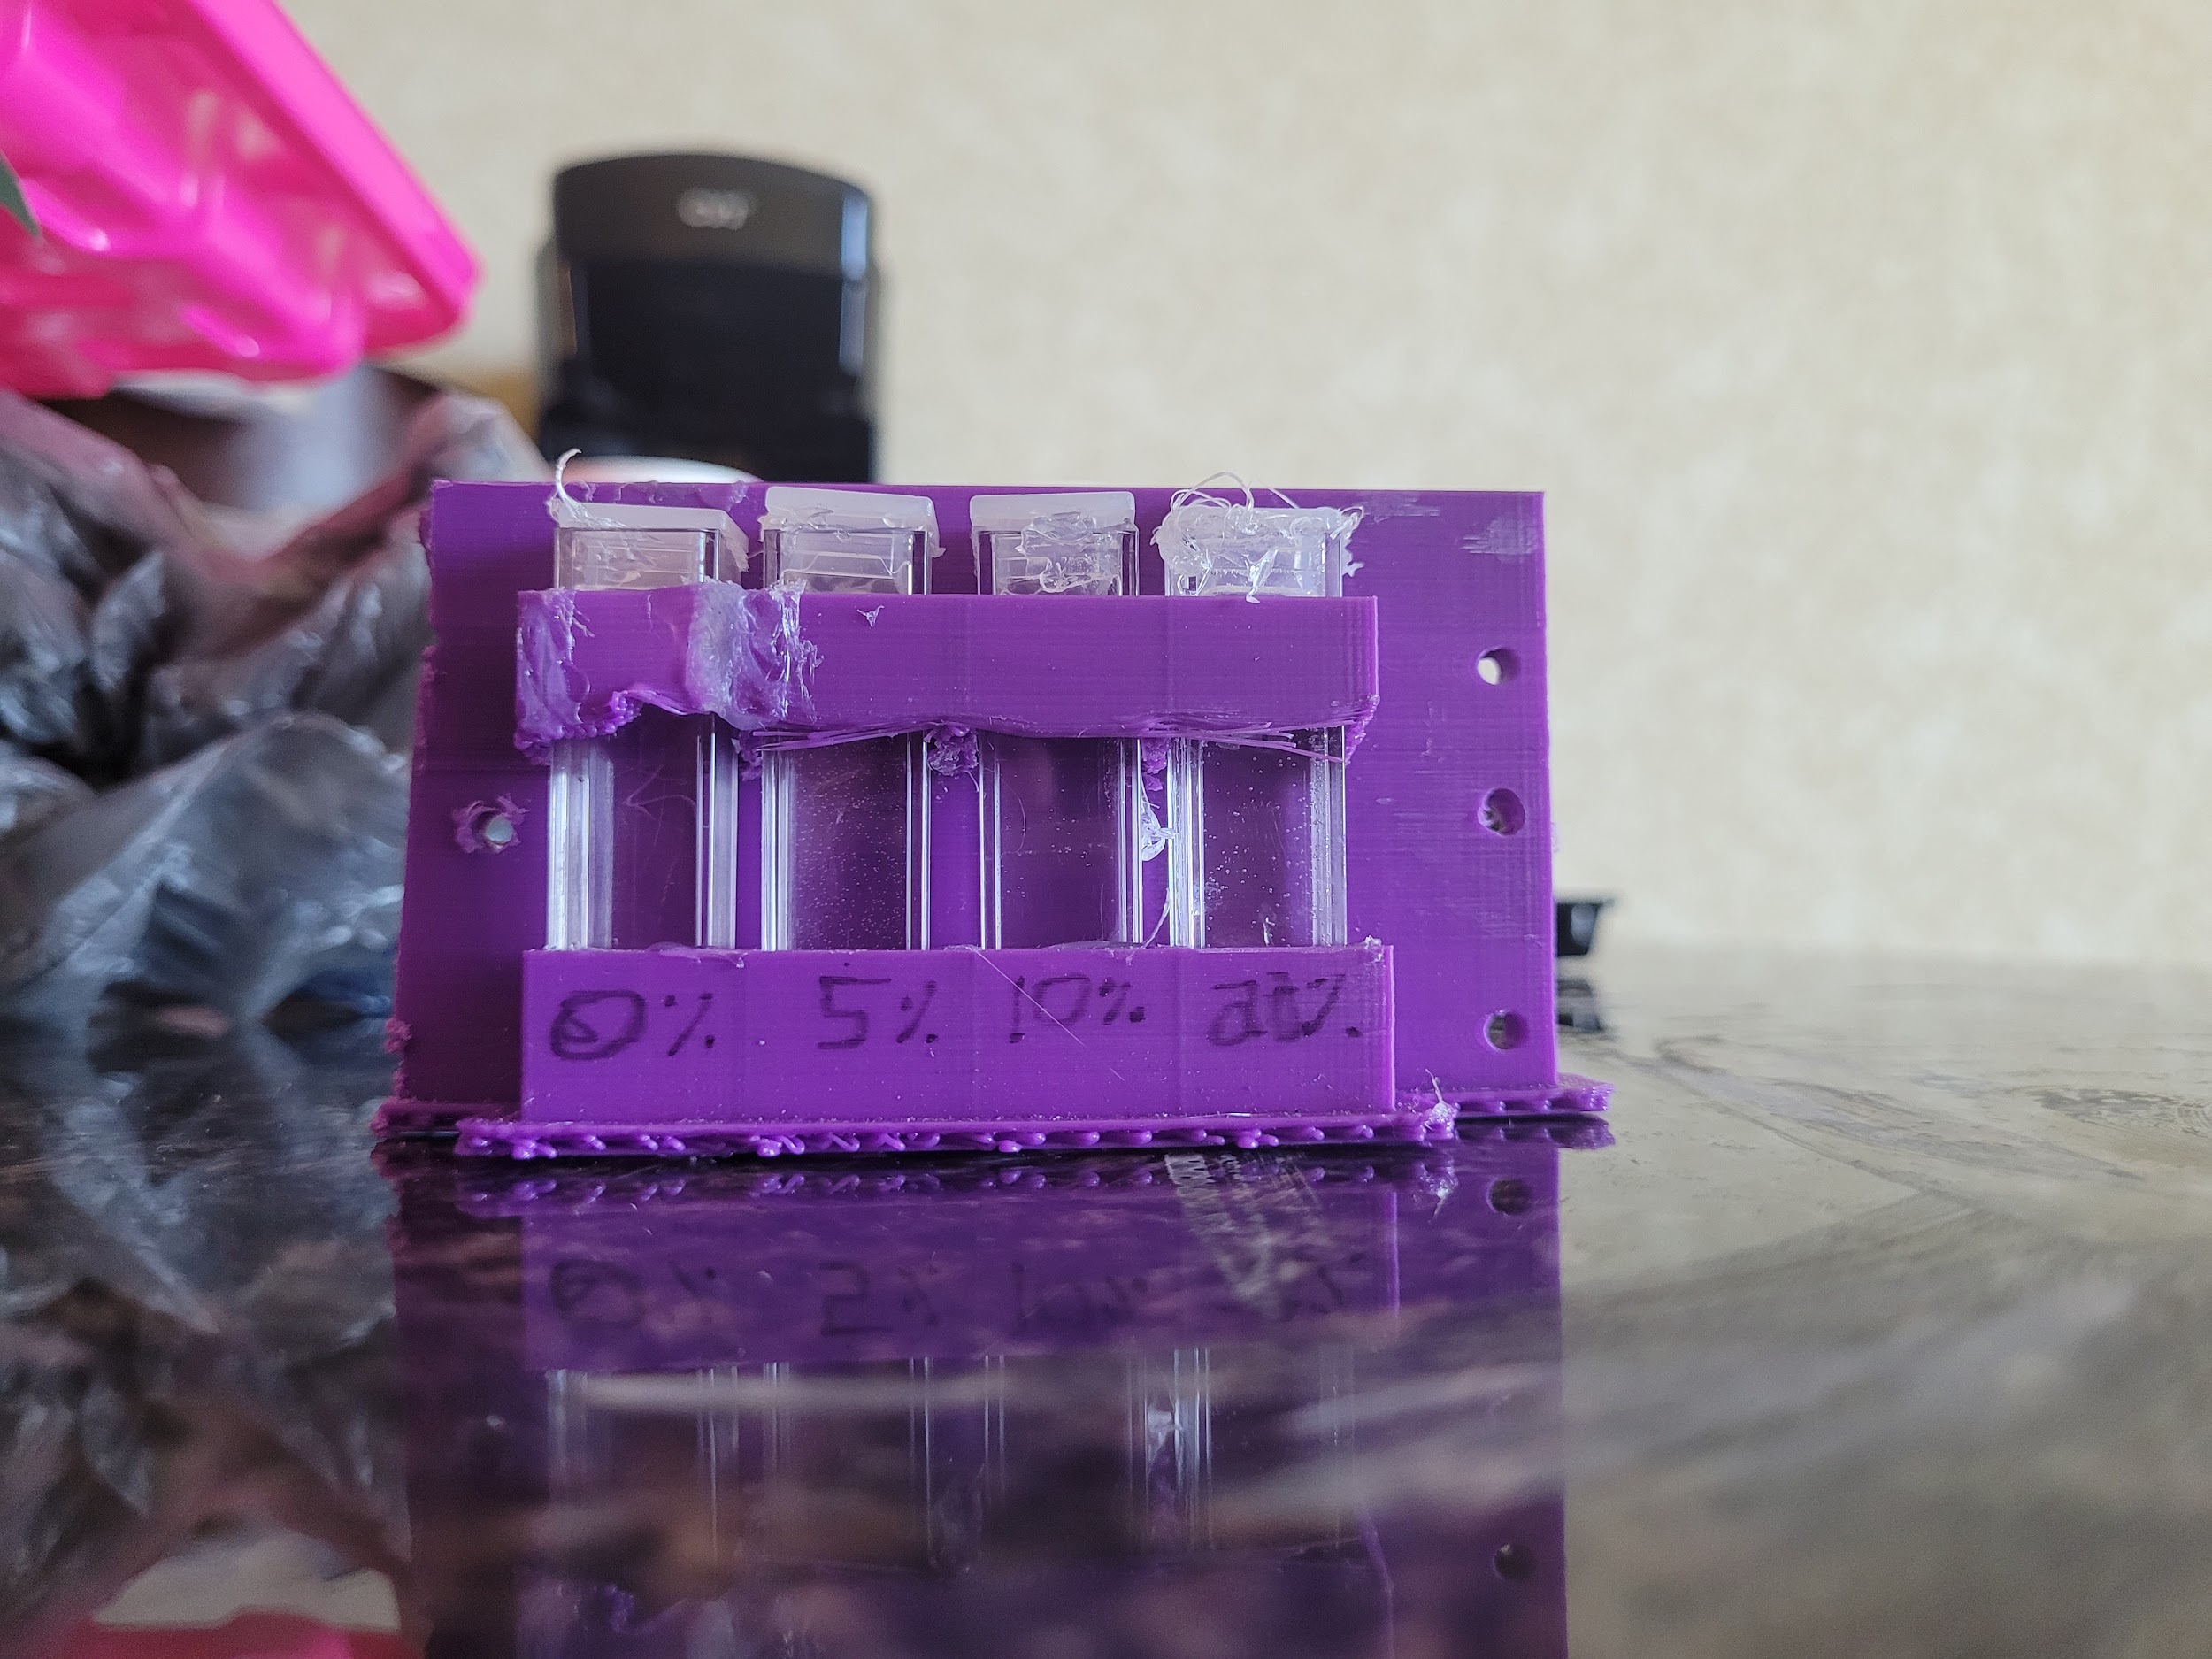
Pictures of Spring Payload

Slide 9
Payload Electronics
The electronics in the Spring semester payload had a few differences in to the Fall semester payload. In the Fall payload, there was an Arduino, data logger, BME 280, C0₂ sensor, an 0₂ sensor, and a PixPro 360 degree camera. However, the Spring payload did not contain a C0₂ sensor or 0₂ sensor, but instead had a cuvette holder and GoPro Hero 7 camera in the interior.

Slide 10
Fall 21 - Flight Result
Data was recorded from the BME for altitude, temperature and humidity for the ascent and the descent. In addition, video footage from the PixPro 360º camera was recorded for the entire ascent.

Slide 11
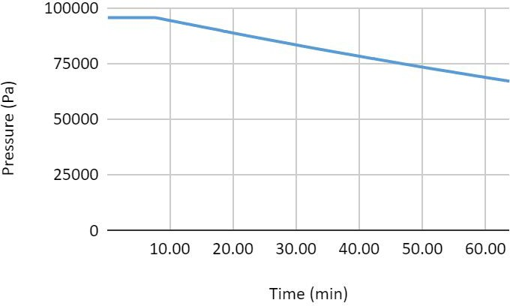
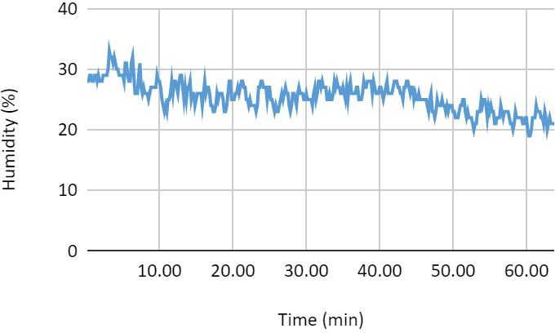
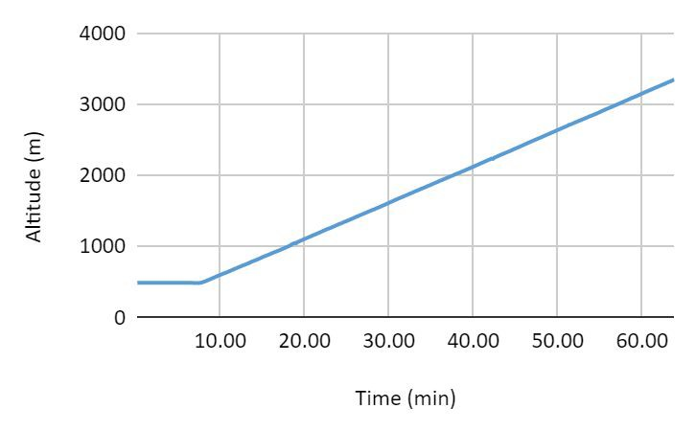
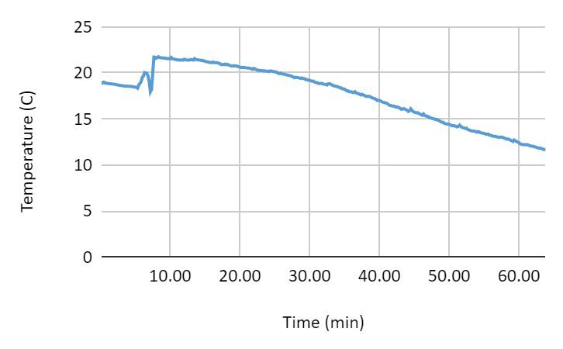
Results
Humidity vs time
Pressure vs time
Altitude vs time
Temp vs time

Slide 12
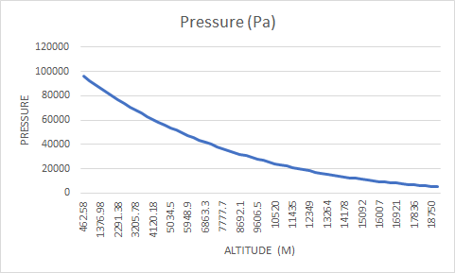
BME DATA

Slide 13
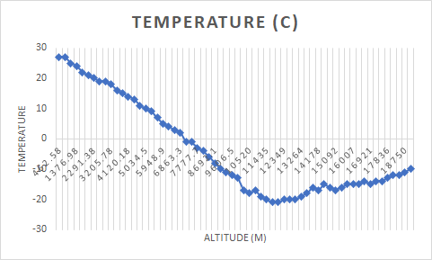
BME DATA

Slide 14
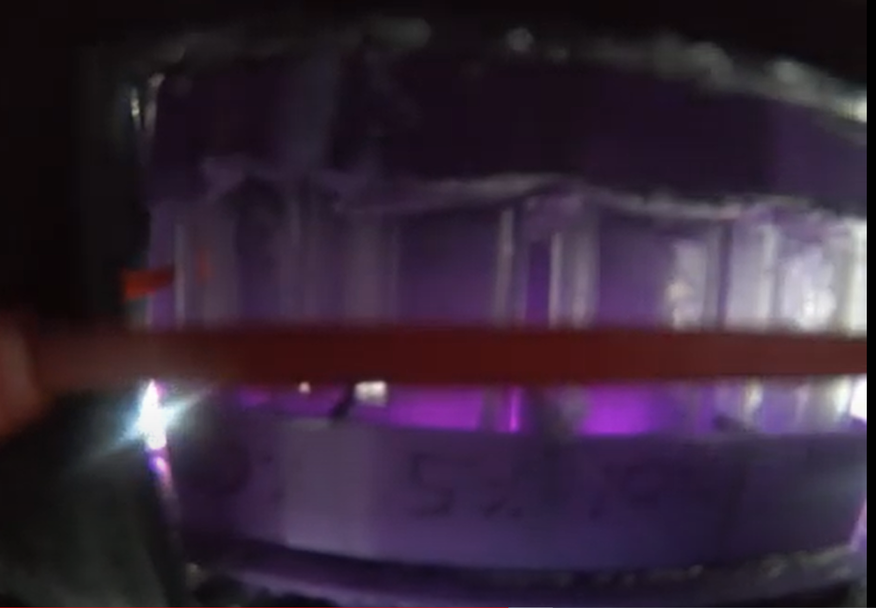
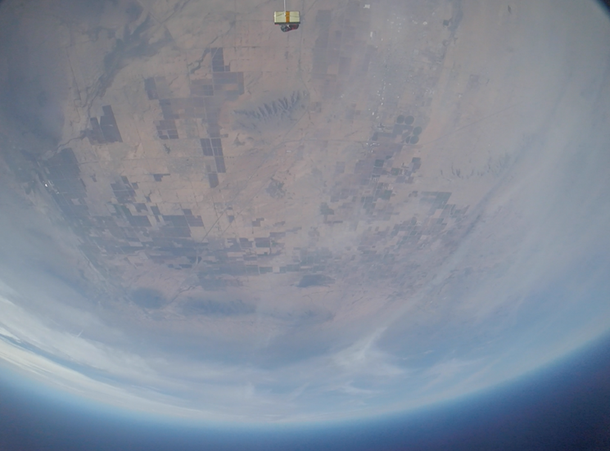
Spring 22 -Flight Result
Earth photo at ~100,000 ft
The internal GoPro camera recorded video for most of the duration of the ﬂight. Data was logged for the entire ﬂight on the data logger, and the payload survived the ﬂight.
Sodium bicarbonate salt solutions
Notes:
Brody needs to discuss the sodium bicarbonate picture, because that is the whole idea of the Spring flight/study. For example, the picture resolution isn’t so great, but that’s due to the proximity of the camera to the cuvettes.

Slide 15
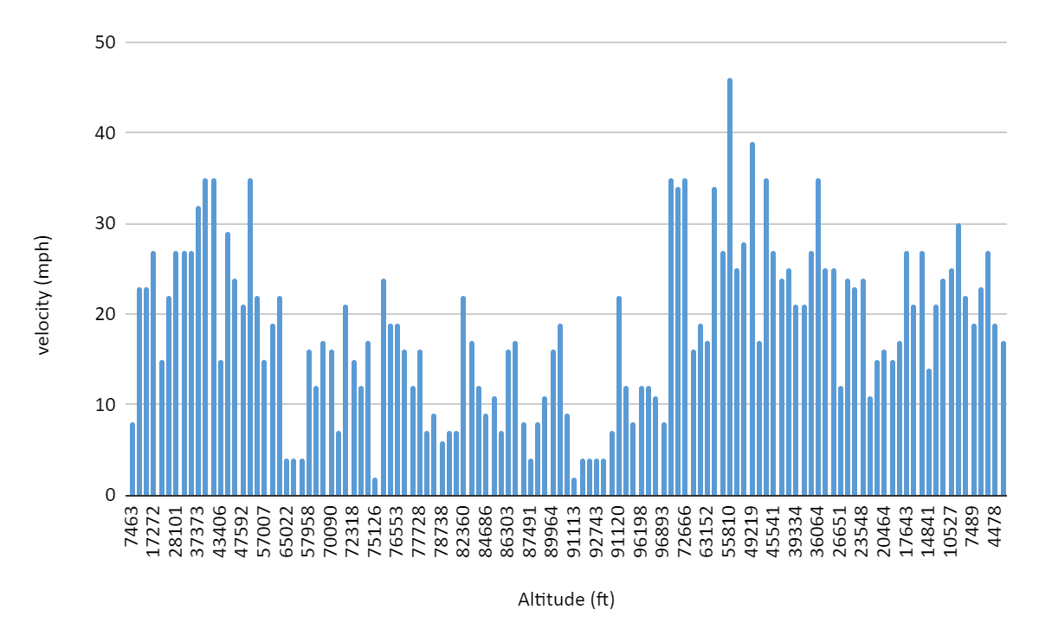
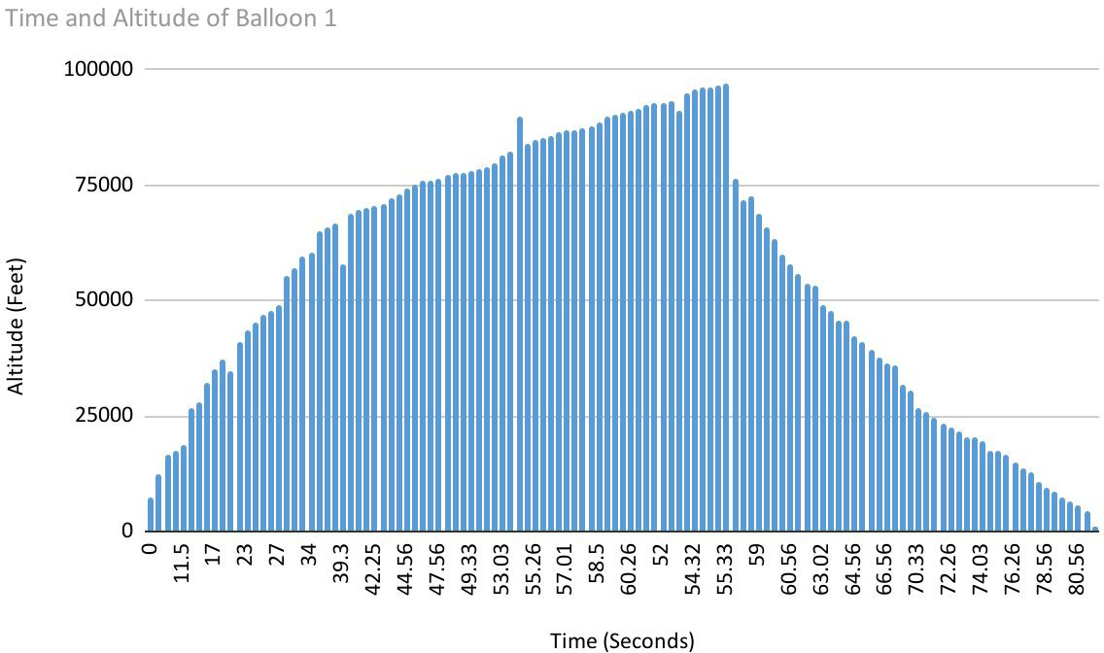
Results
Altitude vs time
Velocity vs altitude
Notes:
Brody: discuss the graphs LHS and RHS and the relationships. RHS graph must be velocity vs. altitude.

Slide 16
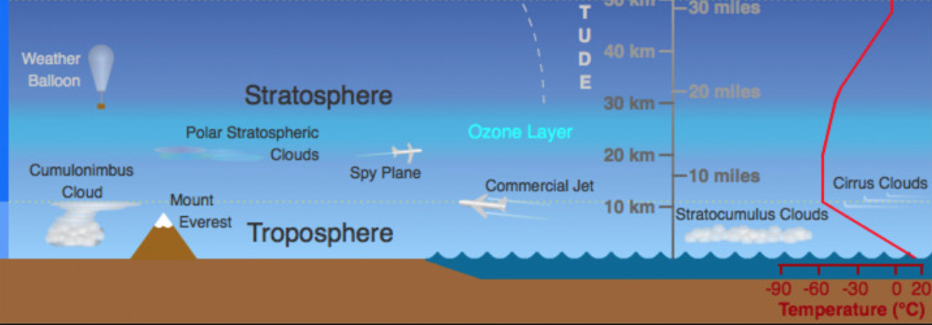
Altitude reached

Slide 17
Conclusion
Lowest atmospheric pressure the human body can withstand is around 6 percent sea level pressure, or 61.8 millibars. In the Spring launch, no conclusive data was obtained with the salt solutions due to the GoPro placement in the interior of the payload. We anticipate this experiment will be revisited in Fall 22. The altitude, temperature, and humidity data recorded is what was expected and verified.

Slide 18



Acknowledgements:
ASCEND
ANSR
NASA
UofA
Pima Community College

